Slide 1

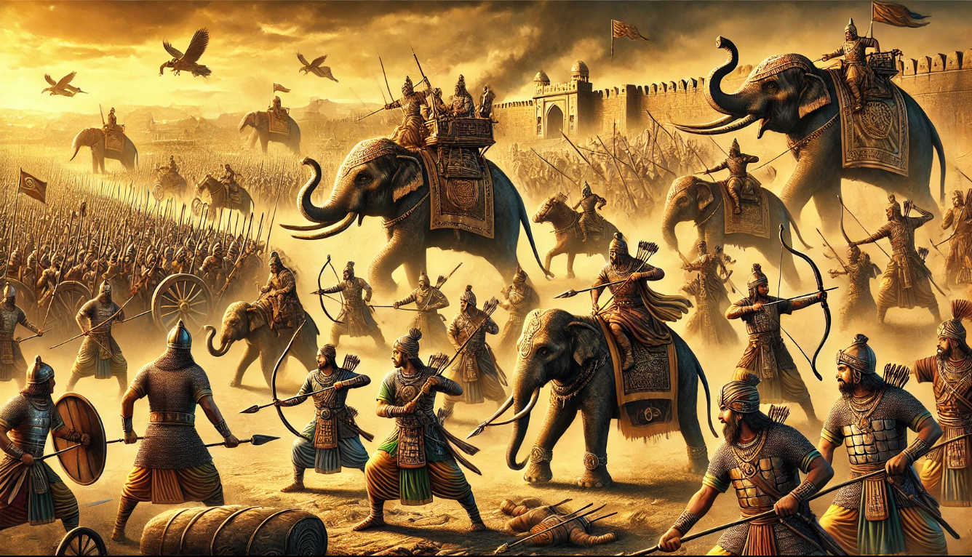
ANCIENT INDIAN WEAPONS
AND
ART OF WARFARE
“Exploring the Valor, Strategy, and Craftsmanship of India’s Martial HeritagE”
Ancient Indian warfare stands as a testament to the ingenuity, skill, and strategic brilliance of its people. From intricately designed weapons like the Urumi and Katar to advanced battle formations like the Chakravyuha, Indian warriors combined technology and tactics to shape the outcomes of history. This presentation delves into the legacy of ancient Indian weapons and the innovative warfare techniques that utilized them, showcasing their impact on battles, culture, and the evolution of military strategies worldwide.

Slide 2
ANCIENT INDIAN WEAPONS
AND
ART OF WARFARE
“Exploring the Valor, Strategy, and Craftsmanship of India’s Martial HeritagE”
-Naina Singh (D115)
The Role of Warfare in Ancient India
WARFARE: Key to territorial expansion and dominance in ancient India.
POLITICAL LANDSCAPE: kingdoms, republics, and empires with constant power struggles.
INFLUENTIAL TEXT: Vedas, Ramayana, Mahabharata etc.
RECRUITMENT: Included troops(maula), mercenaries(bhrita) and forest tribes (atavika).
LEADERSHIP IDEALS: Digvijaya and Chakravarti Samrat.
RELIGIOUS INFLUENCE: Dharma Yuddha in Hinduism and Buddhism.

Slide 3
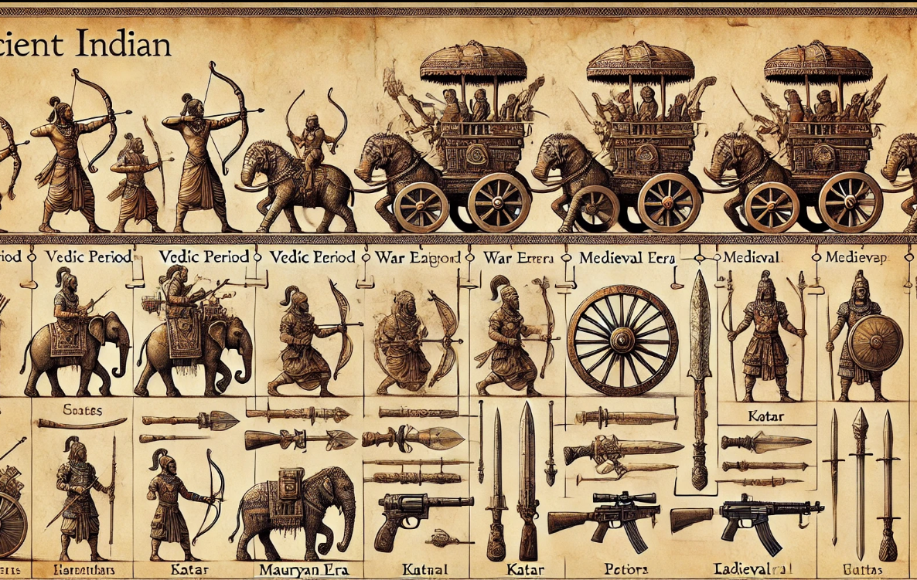
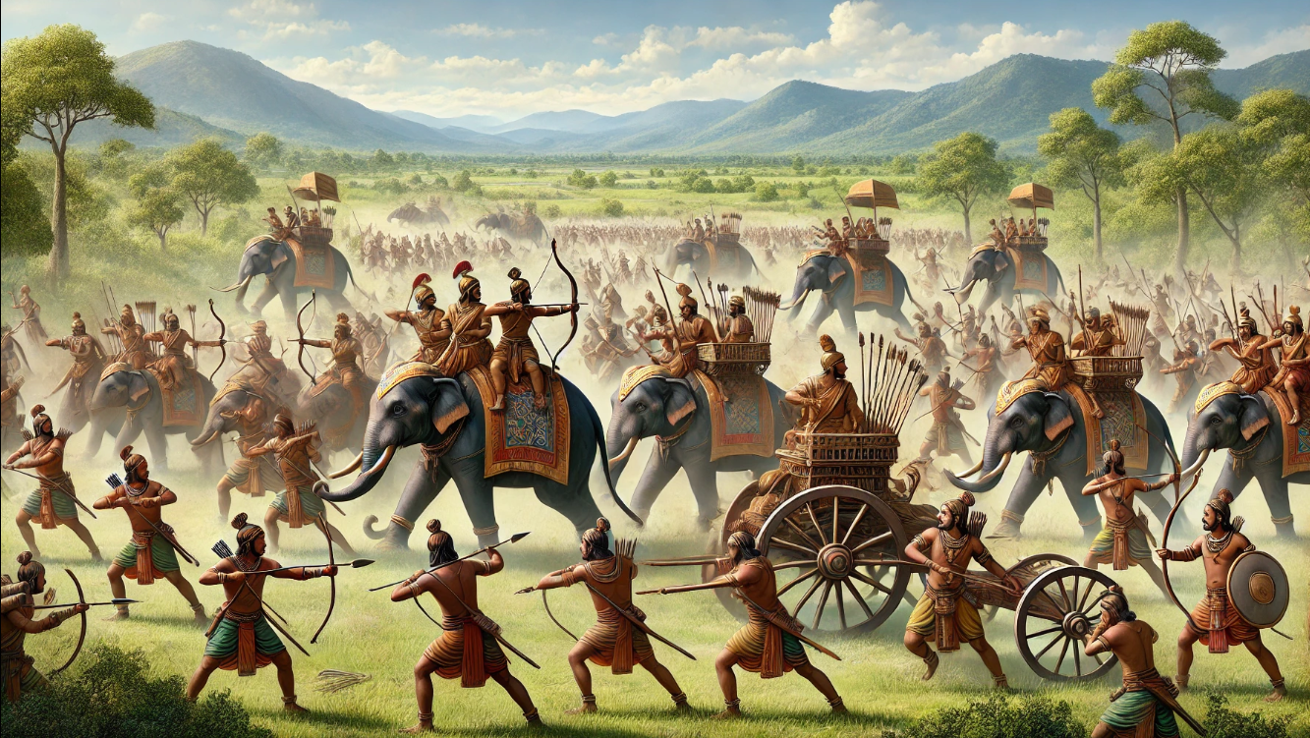
-Naina Singh (D115)
EARLY PERIOD
MEDIEVAL PERIOD
EARLY PERIOD
1500 BCE–500 CE
600-1200CE
Key events, like the Unification Wars under Chandragupta Maurya, the Kalinga War led by Ashoka, and the conflicts during the Gupta Empire.
Ancient Indian warfare was characterized by a diverse range of weapons, each crafted for specific combat
Introduction of innovative weapons like the Katar, Pata, and Vagh Nakh for close combat and guerrilla tactics.
Emphasis on unique regional designs and specialized armaments.

Slide 4
-Naina Singh (D115)
EARLY PERIOD
MEDIEVAL PERIOD
600-1200CE
1500 BCE–500 CE
Introduction of innovative weapons like the Katar, Pata, and Talwar for close combat and guerrilla tactics.
In this period there were Chalukya–Chola wars (992–1120 CE) two battles of Tarrain between Mohommad Ghori and Prithviraj Chauhan
Basic weapons like bows, spears, and chariots in the Vedic period.
Advances in metallurgy during the Mauryan and Gupta empires led to refined swords and the use of war elephants.

Slide 5
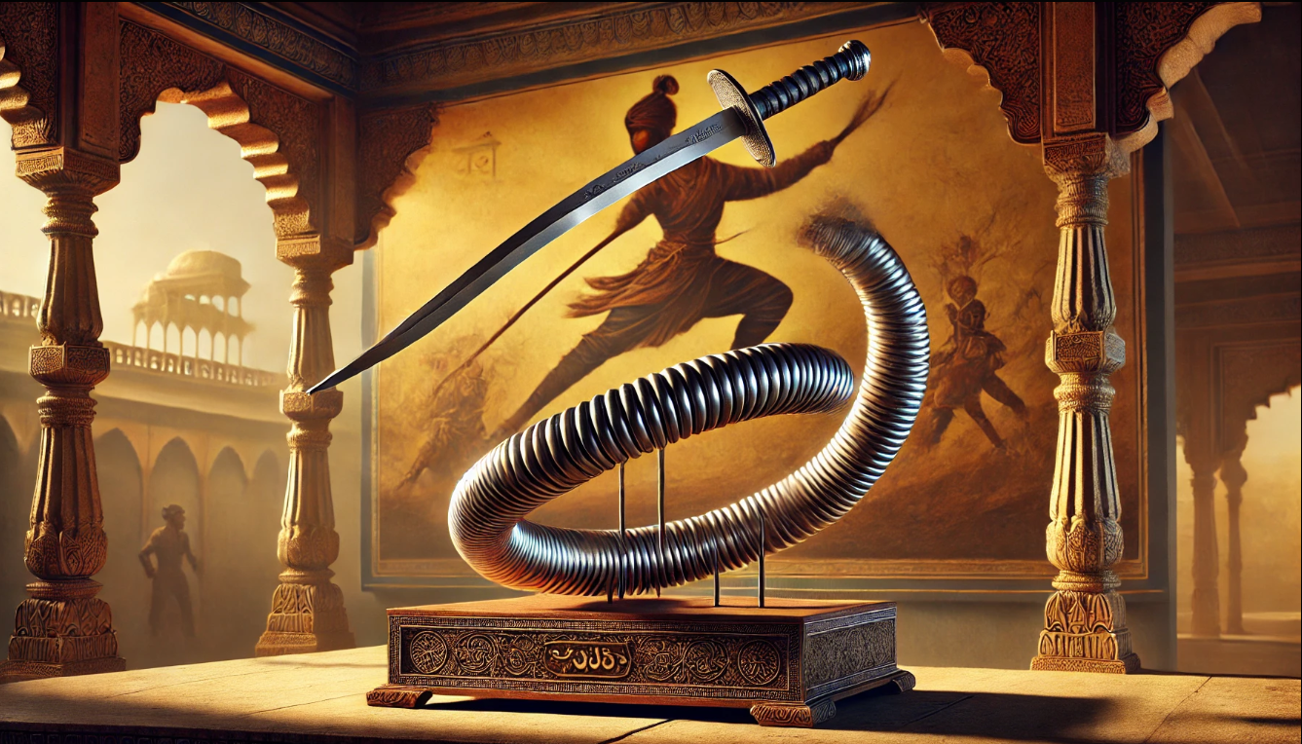
-Naina Singh (D115)
MEDIEVAL PERIOD
LATE PERIOD
1200CE-18th CENTURY
600-1200CE
Introduction of innovative weapons like the Katar, Pata, and Vagh Nakh for close combat and guerrilla tactics.
Emphasis on unique regional designs and specialized armaments.
DEVELOPMENT OF ADVANCED SWORDS LIKE THE TEGHA AND SABRE
INTEGRATION OF TRADITIONAL WEAPONRY WUTH FIREARMS INFLUENCED BY FOREIGN TECHNOLOGIES

Slide 6
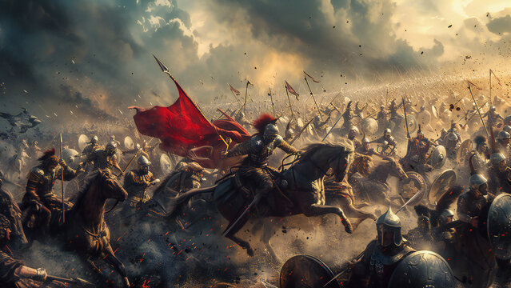
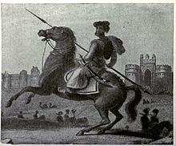
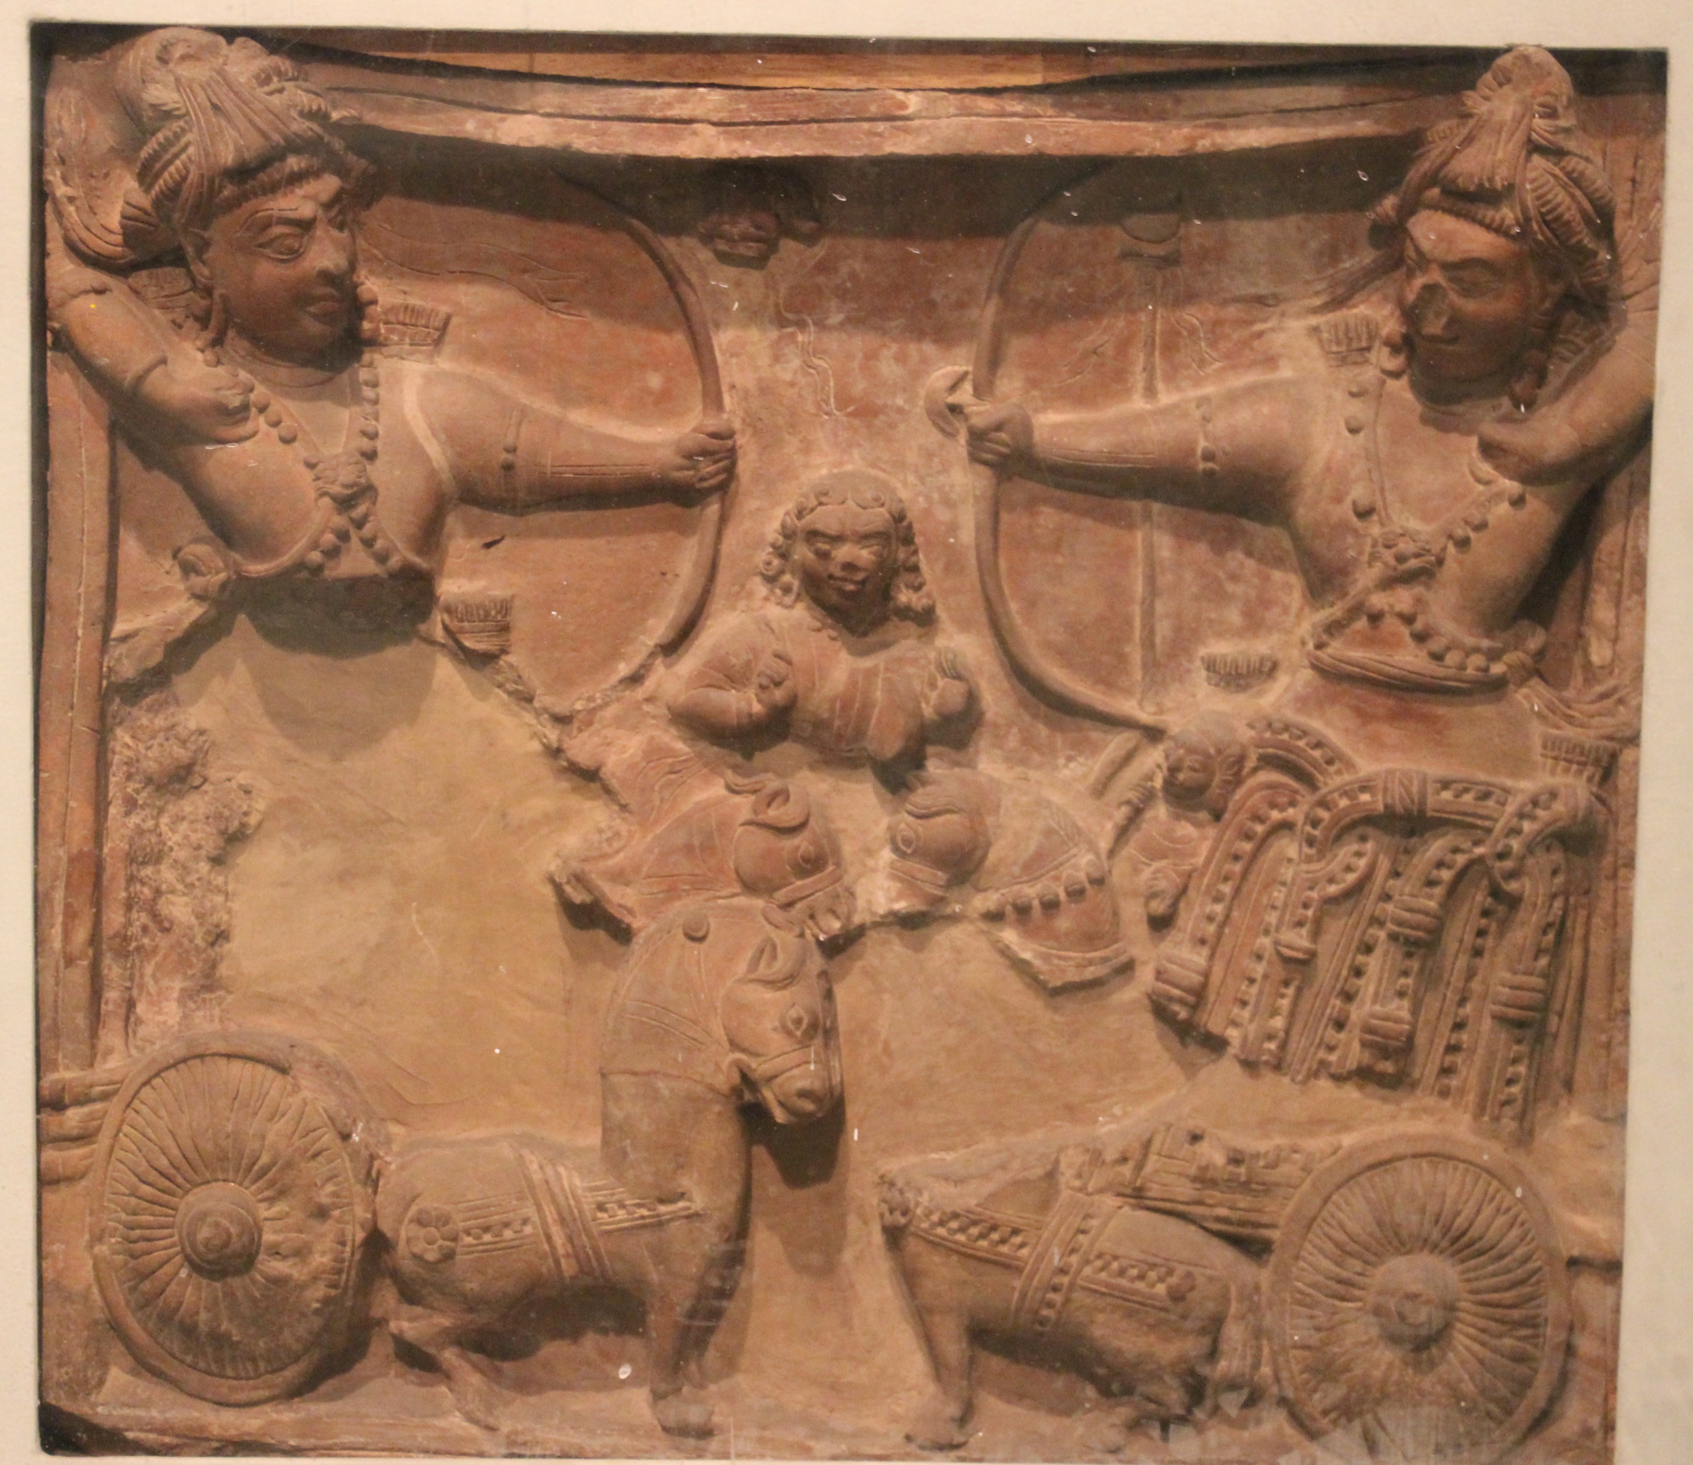
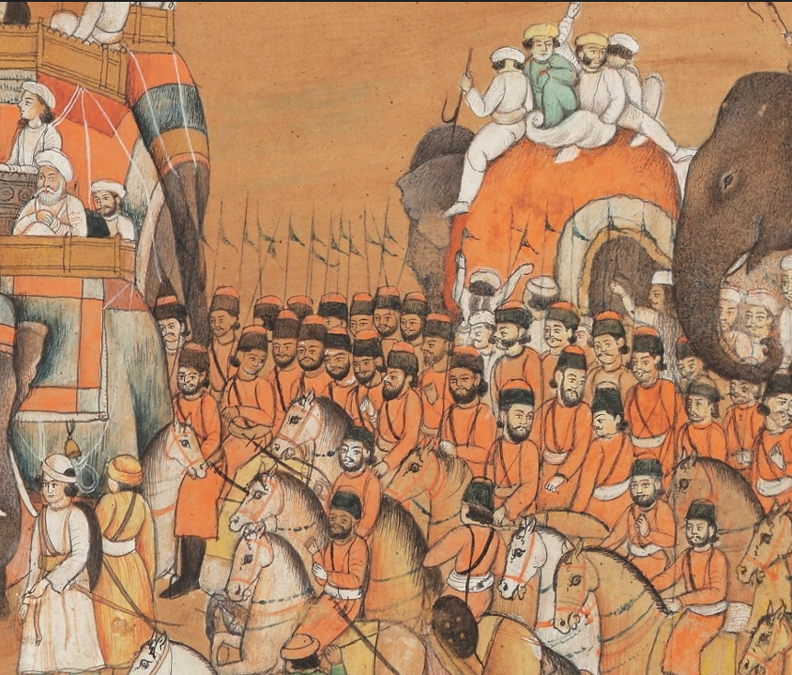
ANCIENT INDIAN ARMY
-Anjali Sinha (D111)
The Mystery and Mastery of Ancient Indian Warfare
STRUCTURE
TRAINING AND
DISCIPLINE
STRATEGIES AND INNOVATIONS

Slide 7
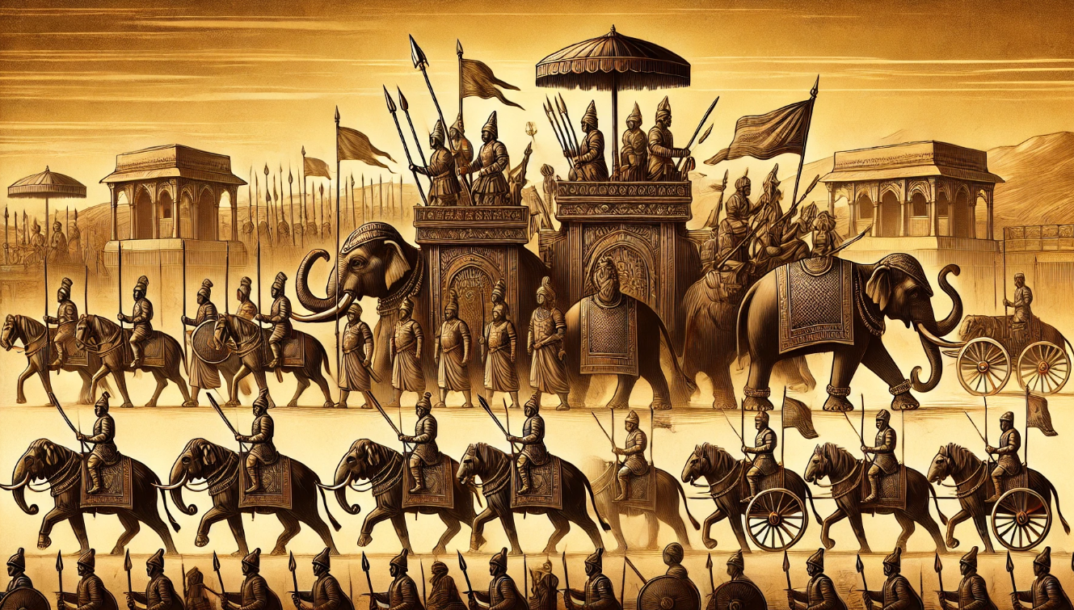
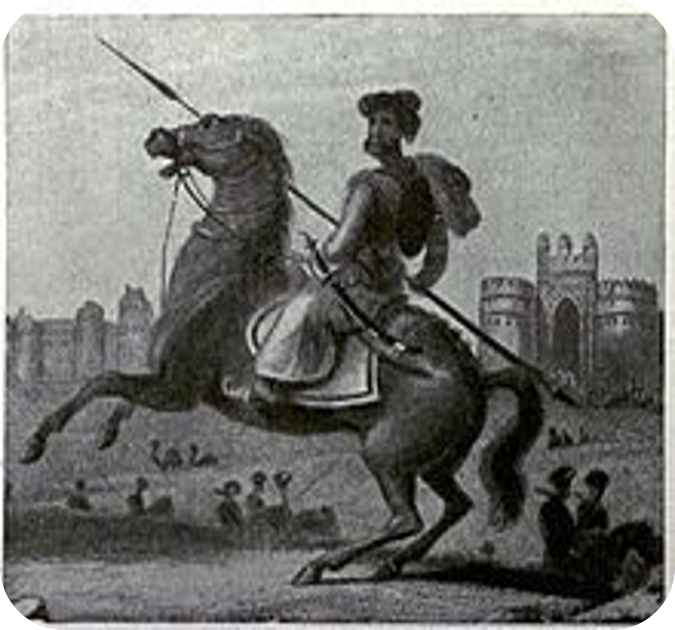
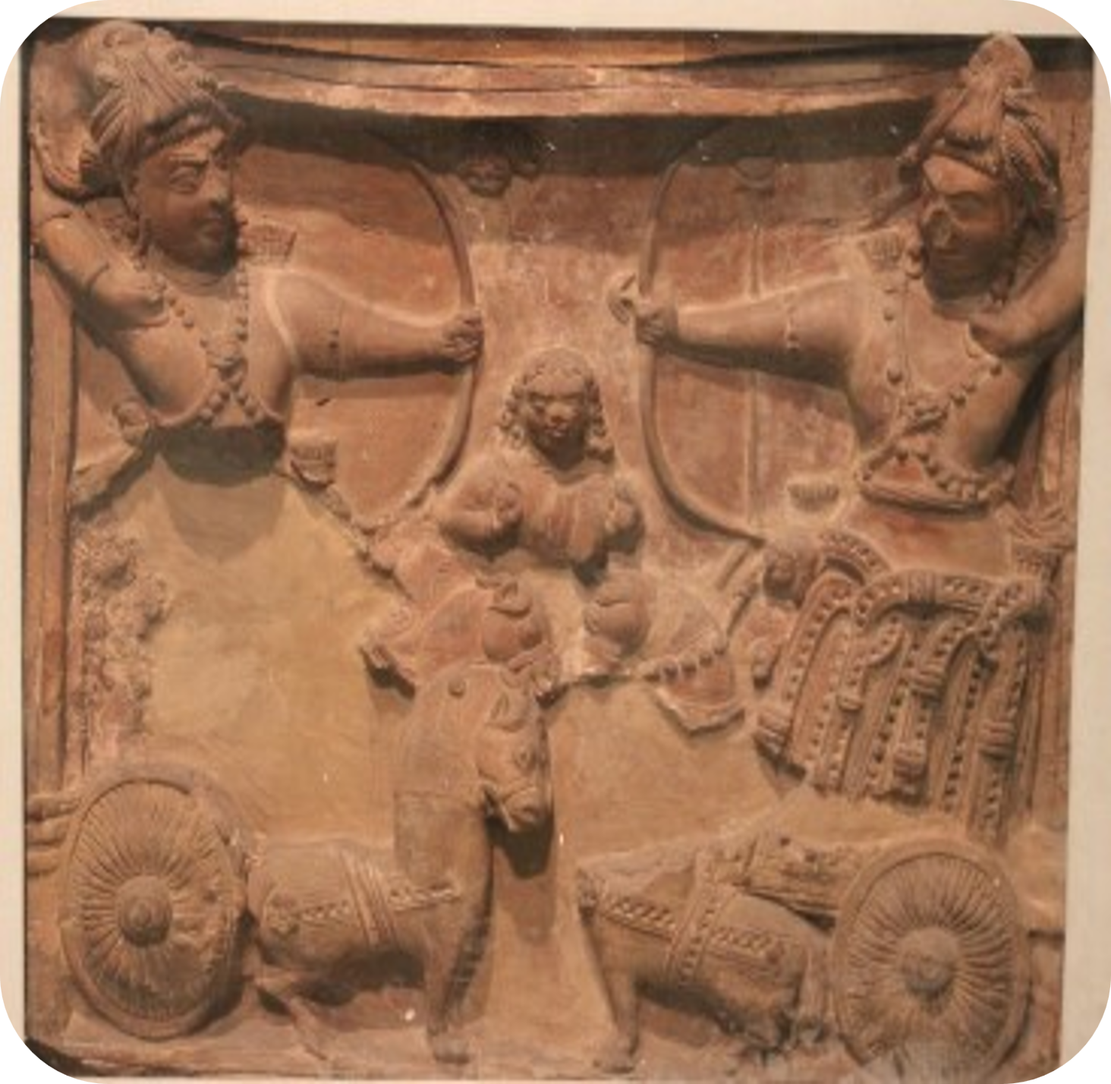
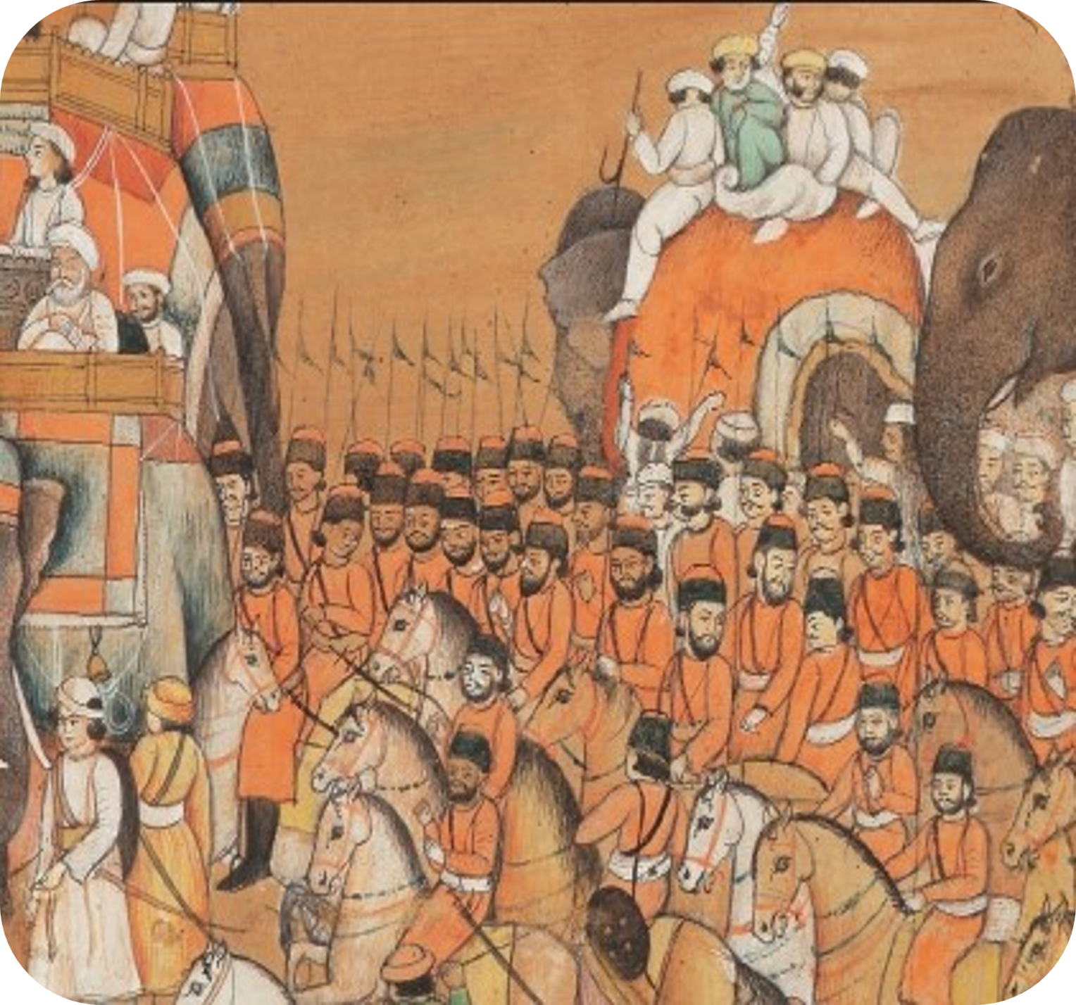
-Anjali Sinha (D111)
STRUCTURE
TRAINING & DISCIPLINE
STRATEGIES & INNOVATIONS
EARLY PERIOD:
Four Divisions (Chaturanga):infantry (padatika), cavalry (ashva), war elephants (gaja), and chariots (ratha).
Battle formation Chakravyuha Ethics Dharma Yuddha Leadership
MEDIEVAL PERIOD:
Combined Arms, Guerrilla Tactics, Siege Warfare
LATE PERIOD:
Artillery Integration, Guerrilla Warfare, Naval Warfare

Slide 8
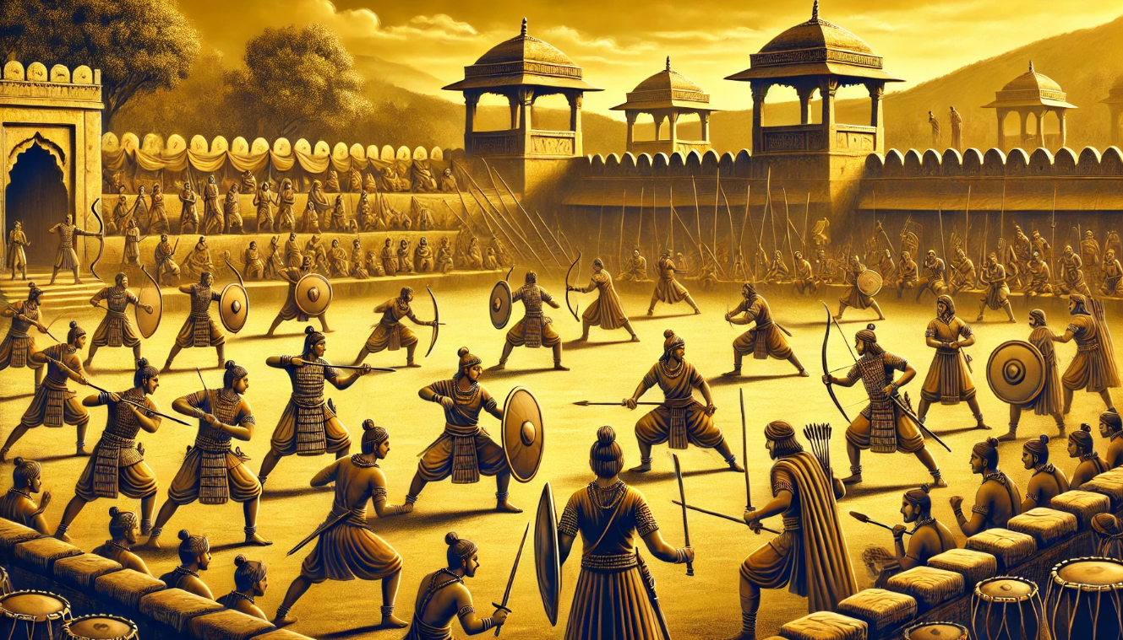
-Anjali Sinha (D111)
TRAINING & DISCIPLINE
STRUCTURE
STRATEGIES & INNOVATIONS
Early Period:
Weapon Training, Martial Arts, Ethical Code
Medieval Period:
Organized Training, Daily Drills, Elephant Corps
Later Period:
Firearms Training, Military Academies, Adaptation to New Technology

Slide 9
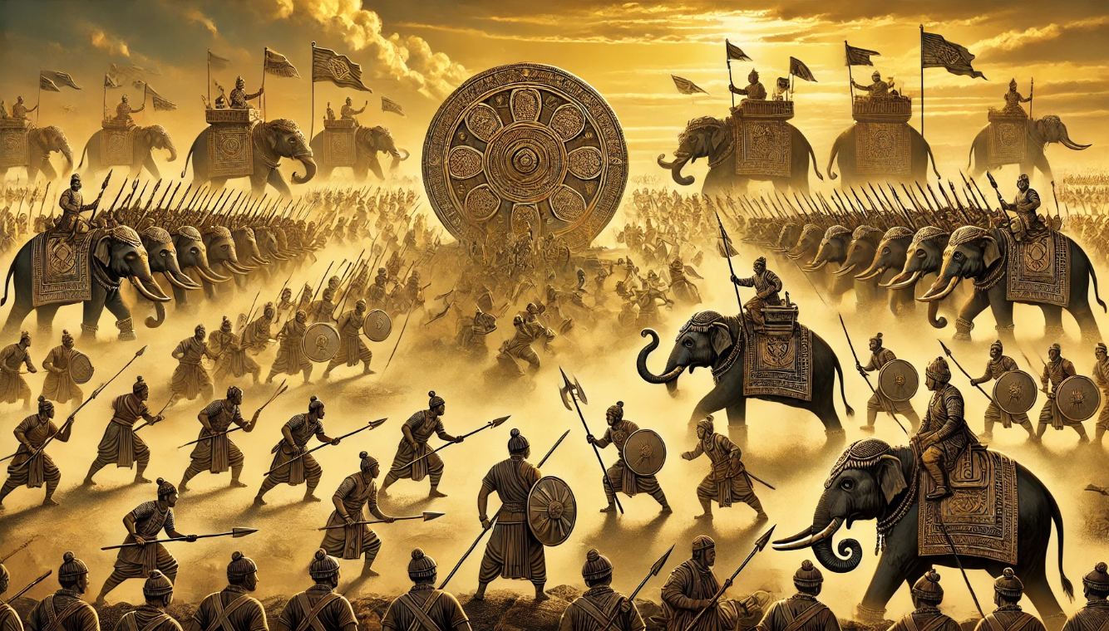
-Anjali Sinha (D111)
TRAINING & DISCIPLINE
STRATEGIES & INNOVATION
STRUCTURE
EARLY PERIOD:
Weapon Crafting: Development of innovative tools like the Chakram and Urumi.
Battle formation Chakravyuha Ethics Dharma Yuddha Leadership
MEDIEVAL PERIOD:
Elephant Armor, Advanced Fortifications, Composite Bows.
LATE PERIOD:
Gunpowder Weapons, Naval Technology, Hybrid Tactics

Slide 10
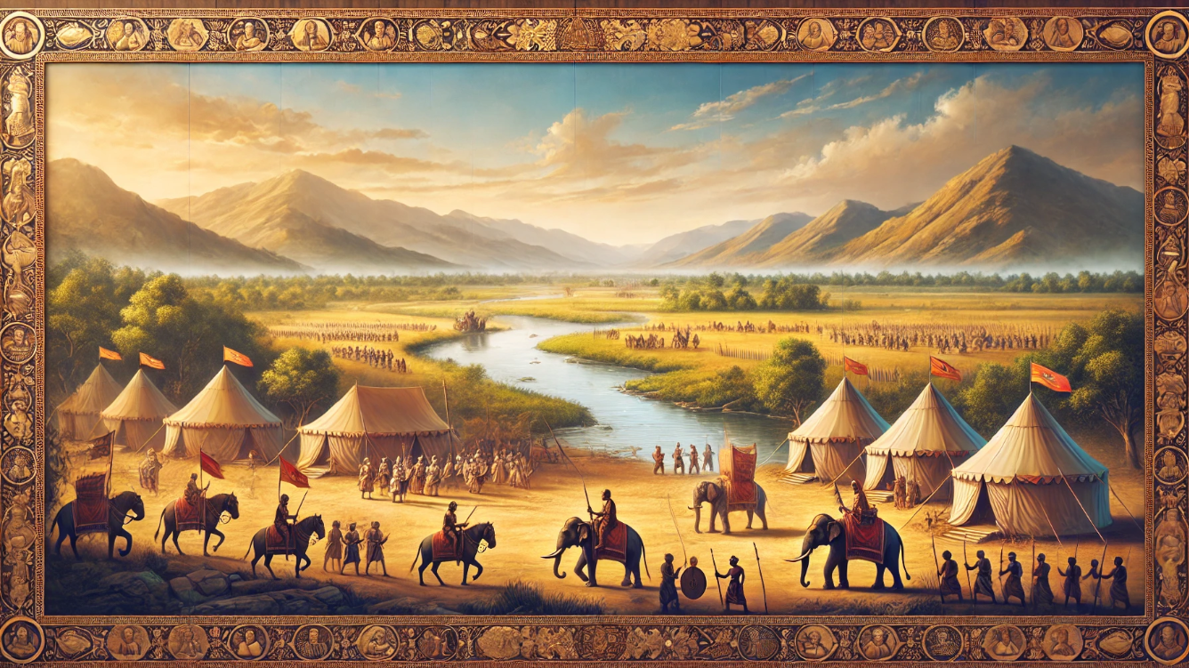




-Anjali Sinha (D111)
Terrain and Location:
often near rivers, plains, or hilly regions to exploit natural advantages.
Example: The Kalinga War was fought near the Daya River, providing strategic positioning.
Notable Ancient Indian Battlefields
Key battlefields include Kurukshetra, Kalinga, Tarain, Panipat, and Hydaspes, shaping India’s historical and military legacy.
01
ANCIENT
INDIAN
BATTLEFIELDS
04
02
Season and Timing:
Dry seasons were preferred for better mobility and logistics.
Monsoons were avoided due to supply chain challenges and difficult terrain.
03
Preparation and Layout:
Camps were set up near battle zones for rest and regrouping.
Defensive structures like trenches, barricades, and moats were utilized.

Slide 11
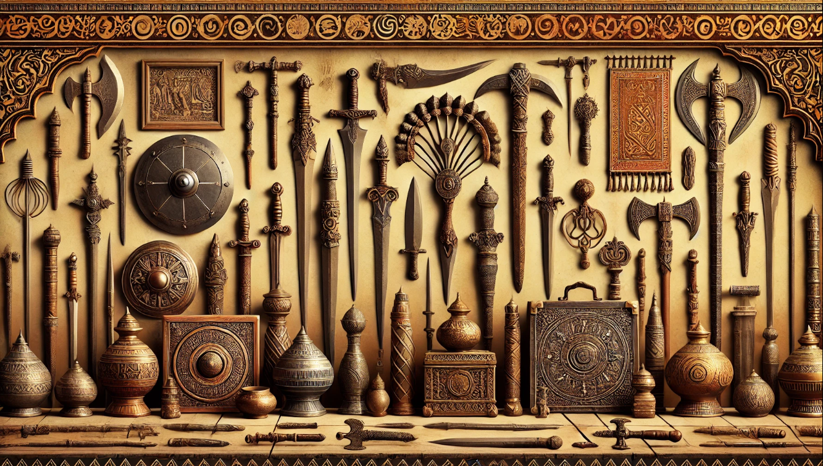
-Vraj Ved (D120)
“BLADES, BLOWS AND BRILLIANCE”
:
EXPLORING
ANCIENT INDIAN WEAPONS

Slide 12
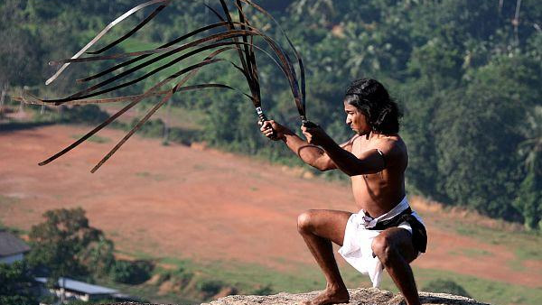
-Vraj Ved (D120)
It is a unique and highly flexible sword originating from southern India,
Known for its long, coiled blade made of high-carbon steel.
Used as both a weapon and a training tool in the Indian martial art of Kalaripayattu.
Its design allows for swift, circular movements, making it highly effective.

Slide 13
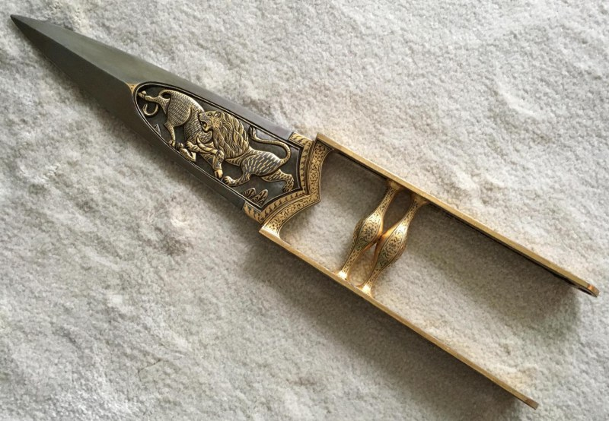
KATAR
It is an iconic punching dagger , distinguished by its unique H-shaped handle that provides a secure grip and allows the blade to align with the user’s arm.
Its innovative design and versatility highlight the craftsmanship and martial ingenuity of ancient Indian warriors.
It also enables powerful thrusts capable of piercing armor and shields.
-Vraj Ved (D120)

Slide 14
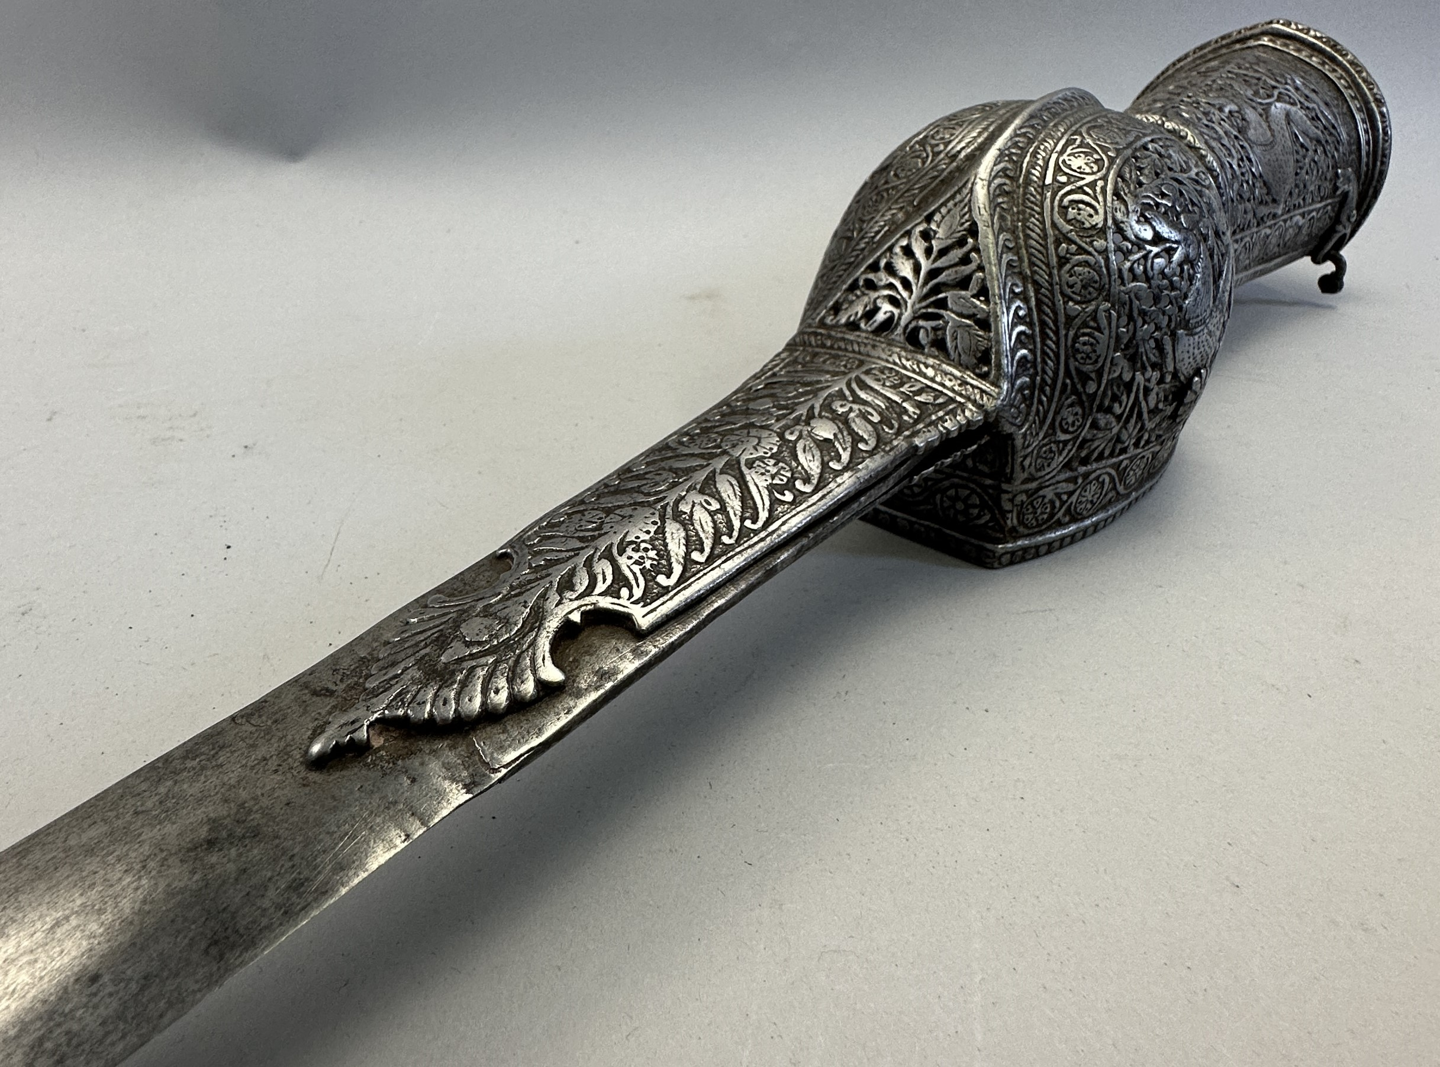
PATA
The Pata, or gauntlet sword, is a distinctive weapon, characterized by its long, straight blade attached to a protective gauntlet that shields the user’s hand and wrist.
This design provided extended reach and enhanced defense in combat, making it ideal for both dueling and battlefield scenarios.
The Pata required specialized training to master its thrusting and sweeping techniques.
-Vraj Ved (D120)

Slide 15
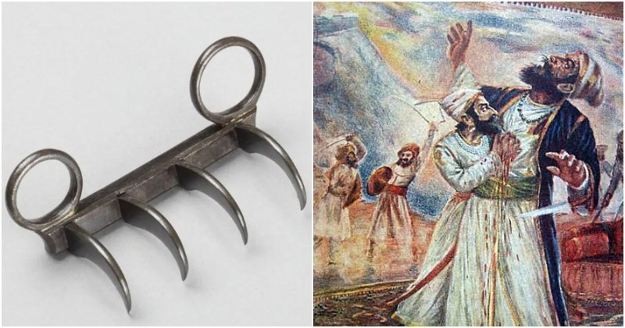
Vagh Nakh
The Vagh Nakh, or "Tiger Claws," is a concealed weapon with sharp, curved blades designed to mimic a tiger's claws.
It was primarily used for stealth and close-combat situations, allowing warriors to deliver fatal strikes while maintaining mobility.
Famously wielded by Shivaji Maharaj to defeat Afzal Khan, the Vagh Nakh symbolized strategic ingenuity and mastery of guerrilla tactics in Indian warfare.
-Vraj Ved (D120)

Slide 16
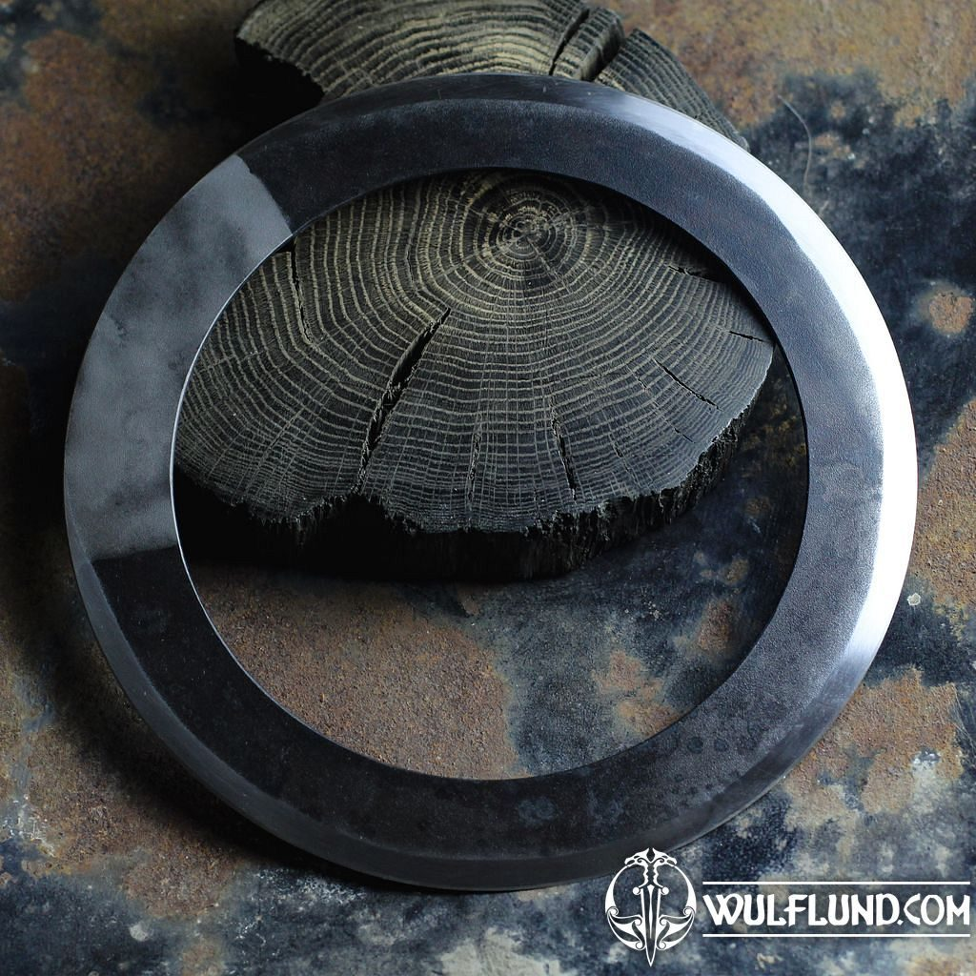
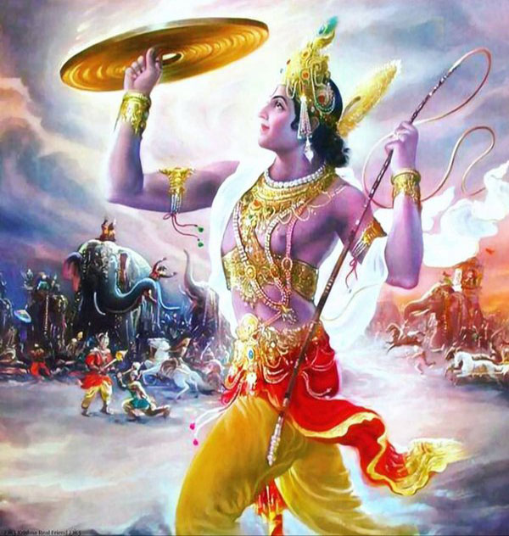
-Darshan Ved (D121)
The Chakram, a circular throwing weapon with sharp edges, was a key part of ancient Indian warfare. Used for ranged attacks, it could be thrown with precision to injure or disarm opponents from a distance.
Known as the Sudarshan Chakra, this celestial weapon symbolized justice and protection. Krishna wielded the Sudarshan Chakra with unmatched precision, using it to vanquish evil forces and restore dharma (righteousness).
It remains a powerful symbol of divine strength, skill, and moral authority in Indian culture.

Slide 17
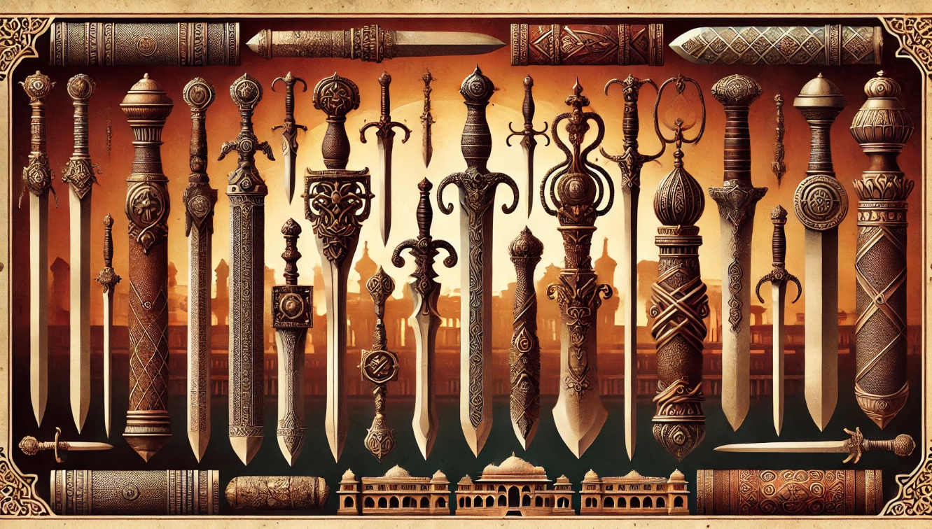
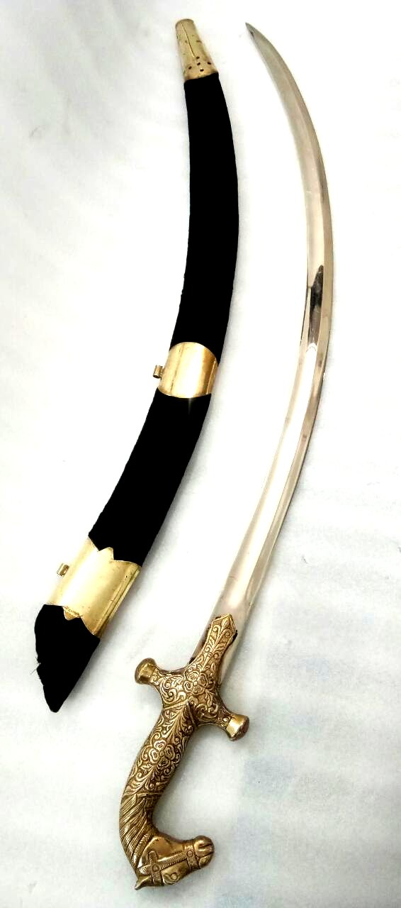
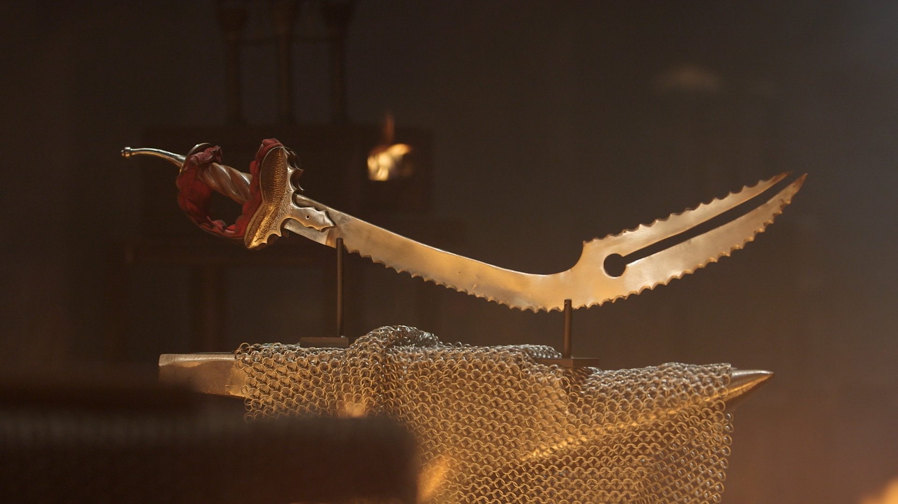
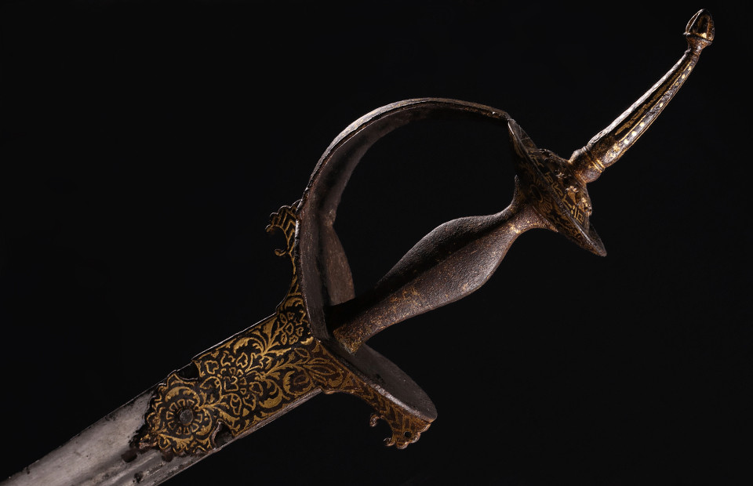
3 MAIN TYPES OF TALVAR
-Darshan Ved (D121)
Design: A heavier, broader variant of the talwar with a curved blade for powerful slashing attacks.
Effectiveness: Ideal for close combat and cavalry charges due to its weight and cutting efficiency.
Craftsmanship: Often adorned with intricate engravings, showcasing Indian artistry and symbolism of valor.
TEGHA
FIRANGI
SERRATED SABRE

Slide 18
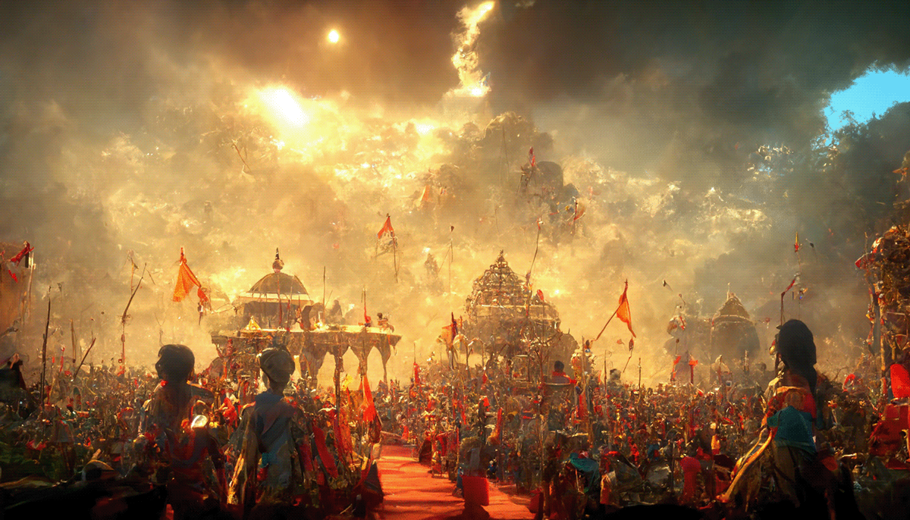
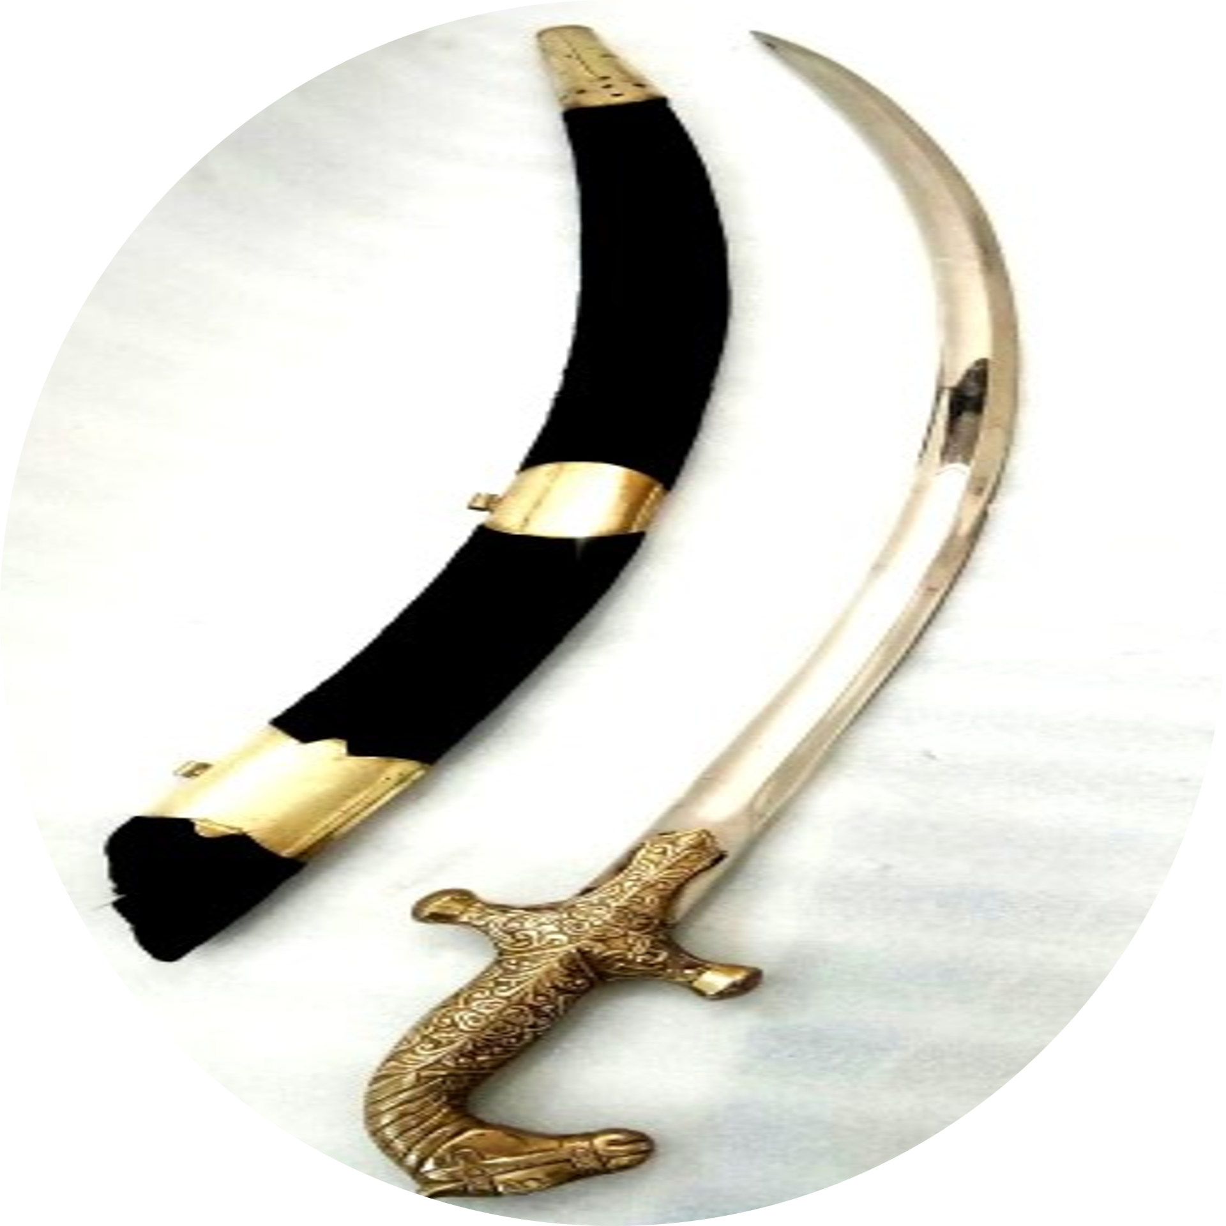
Unique Blade: Features a serrated edge, designed to tear through armor or shields effectively.
Combat Use: Ideal for close combat where cutting and ripping actions were needed.
Craftsmanship: Decorated with detailed engravings, reflecting the regional styles of ancient India.
-Darshan Ved (D121)
TEGHA
SERRATED SABRE
FIRANGI

Slide 19
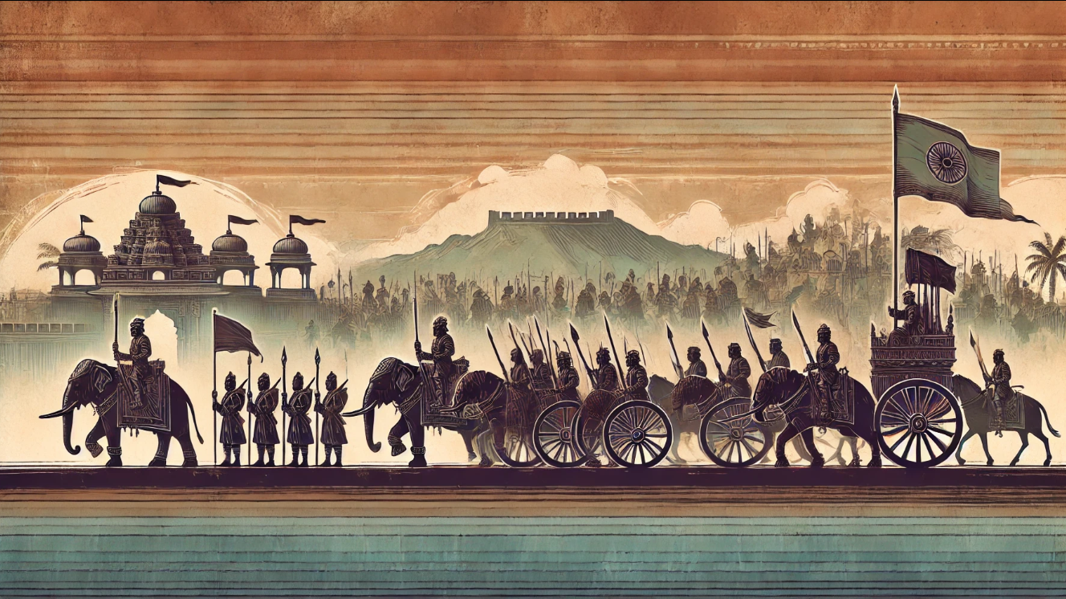
Long Blade: A straight, slender blade often crafted from imported European steel, blending Indian and Western designs.
Versatility: Used by infantry and cavalry, offering extended reach and precision.
Symbolism: Represented the fusion of foreign influences with Indian martial traditions.
-Darshan Ved (D121)
TEGHA
FIRANGI
SERRATED SABRE

Slide 20
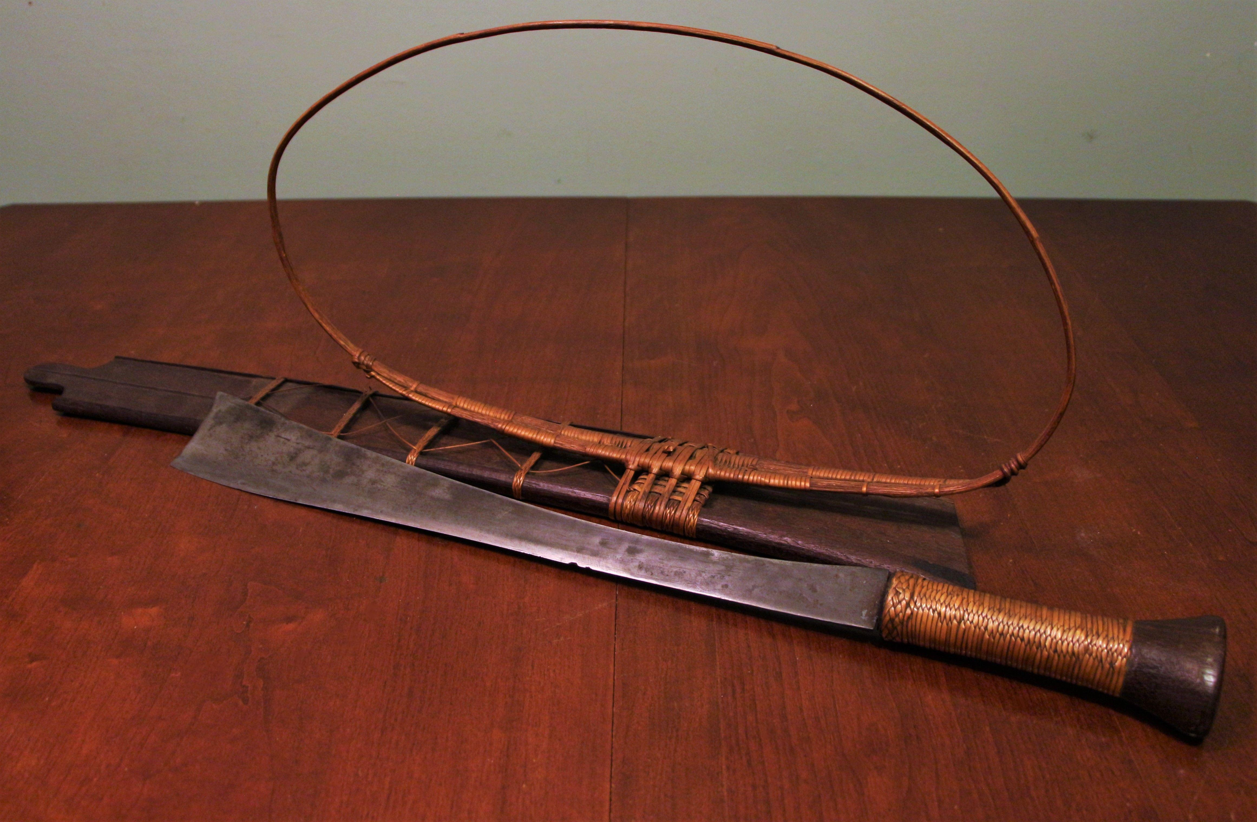
-Darshan Ved (D121)
NAGA
The Naga Sword, or Dao, is a traditional weapon of the Naga tribes, known for its broad, curved blade designed for swift slashing attacks. Crafted from local materials and often adorned with tribal motifs, it was used in both warfare and ceremonial practices..

Slide 21
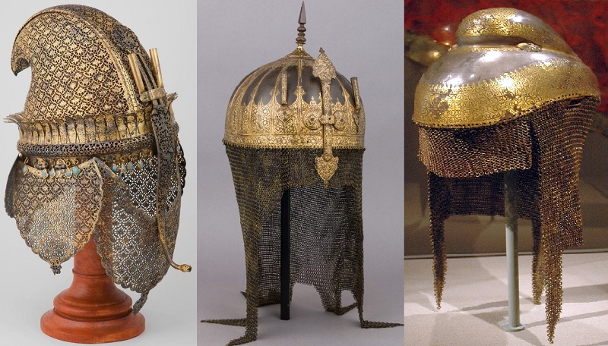






Aesthetic and Functional Balance
Materials and Craftsmanship
Made using leather, iron, bronze, steel, and padded textiles, with intricate designs reflecting cultural and religious motifs.
Lightweight and durable, adapted to India's hot climate, with artistic engravings showcasing the rich cultural history.
Types of Armours
Legacy
ANCIENT
INDIAN
ARMOURS
Included scale armour, chainmail, and plate armour, balancing protection and mobility.
Many pieces are preserved in museums and serve as a testament to India's craftsmanship and heritage.
Regional and Historical Influence
Notable Pieces
Iconic examples include the Chahar-Aina (Four-Mirror Armour) and ornate Dhal (shields).
Designs evolved due to regional conflicts and the influence of Persian, Greek, and Central Asian techniques.
-Abhishek Upadhyay (D119)

Slide 22
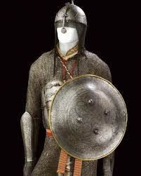
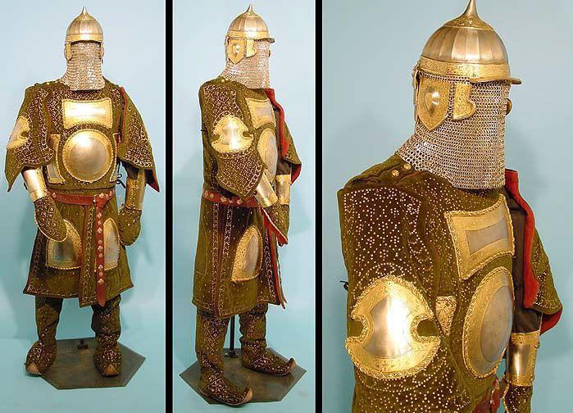
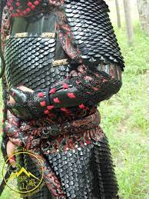
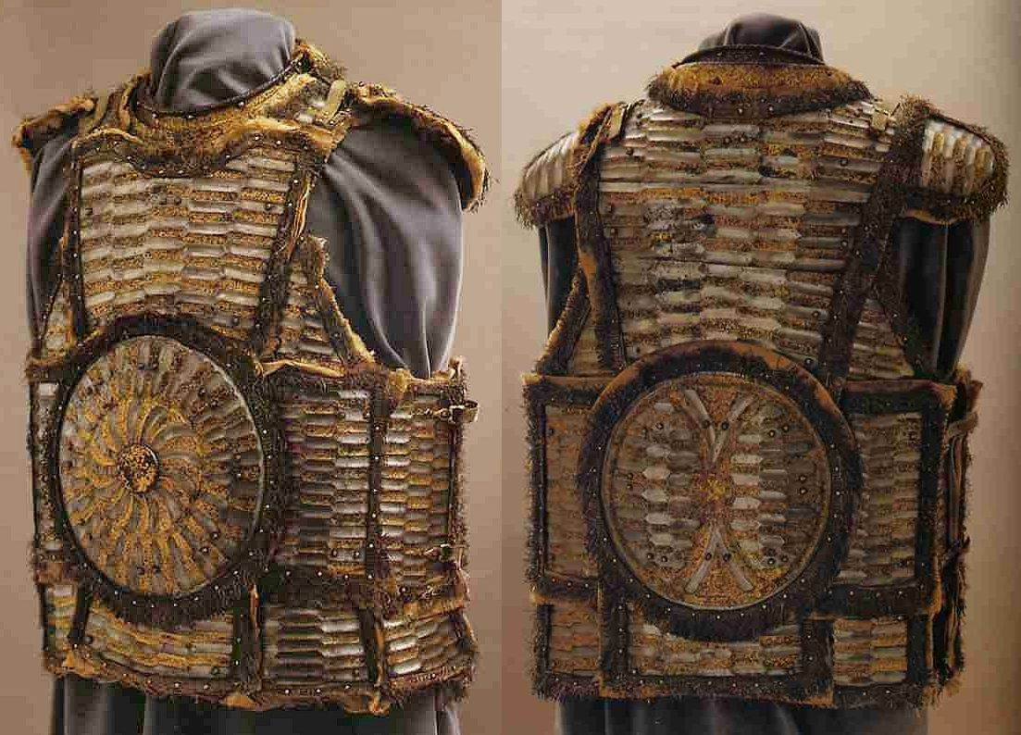
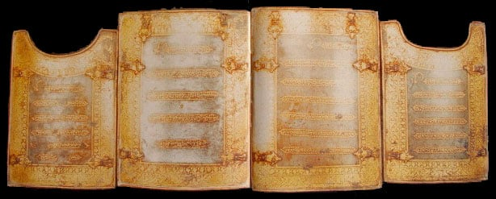
IRON AND STEEL ARMOUR
BRONZE ARMOUR
SCALE ARMOUR
TYPES OF ANCIENT ARMOURS
CHAHAR AINA ARMOUR
-Abhishek Upadhyay (D119)

Slide 23
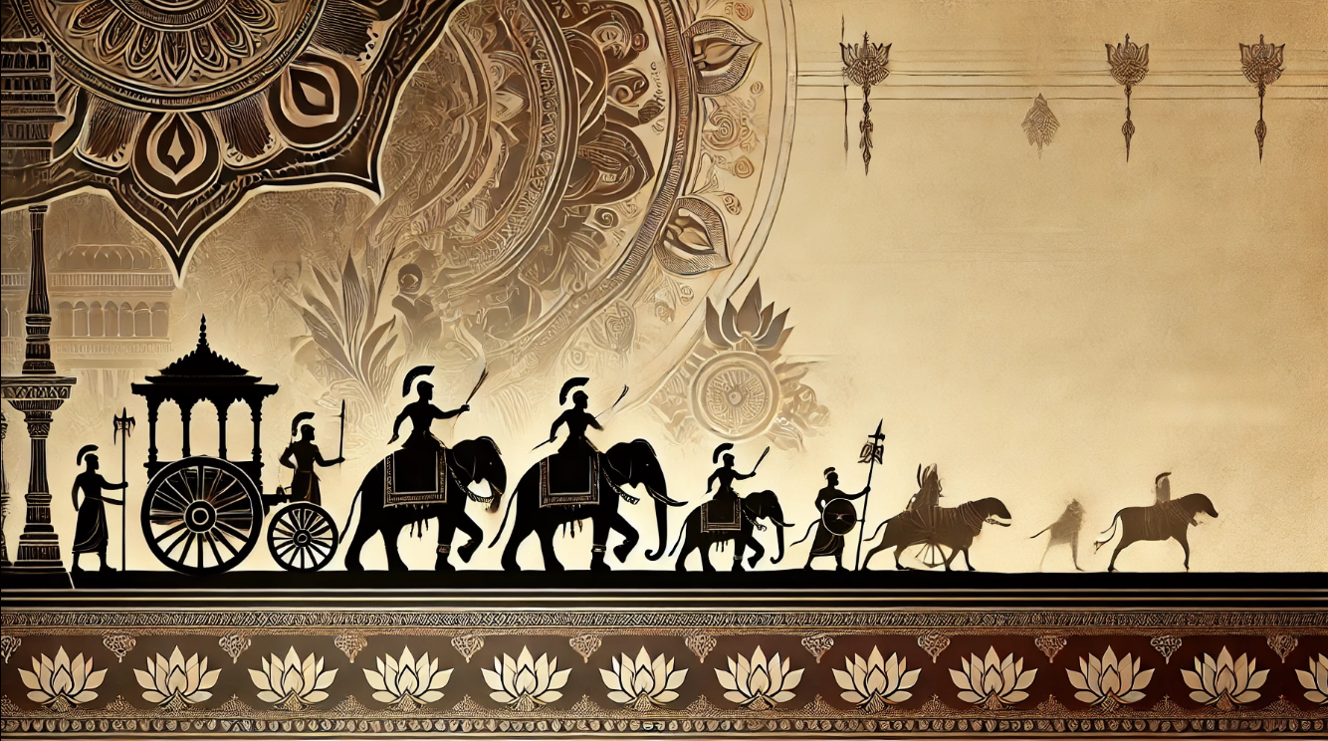




ANCIENT INDIAN COMMAND STRUCTURE
SUPREME LEADER
01
The King or Emperor acted as the commander-in-chief, with absolute authority over military operations.
MILITARY HIERACHY
Senapati (General) led the forces, supported by regional commanders like Mahasenapati, and specialized leaders for elephants, cavalry, infantry, and chariots.
02
03
UNIT AND AUXILIARY LEADERS
Local chieftains, tribal leaders, and Dandadhyakshas managed smaller units and auxiliary troops
SUPPORT SYSTEM
Engineers, spies, medics, and logistical staff ensured smooth operations and strategic success.
04
-Abhishek Upadhyay (D119)

Slide 24
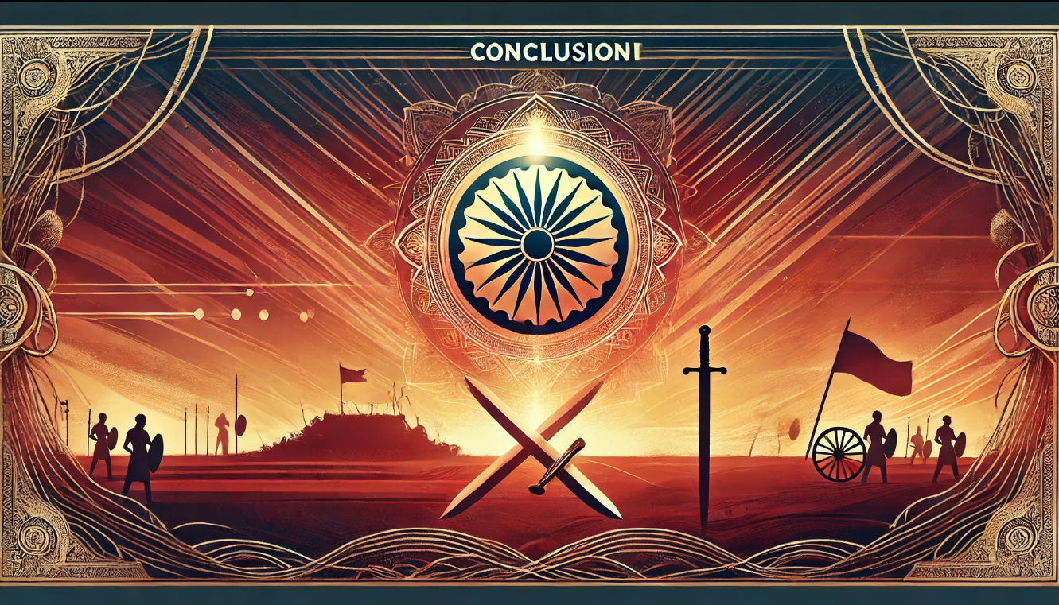
-Abhishek Upadhyay (D119)

Slide 25
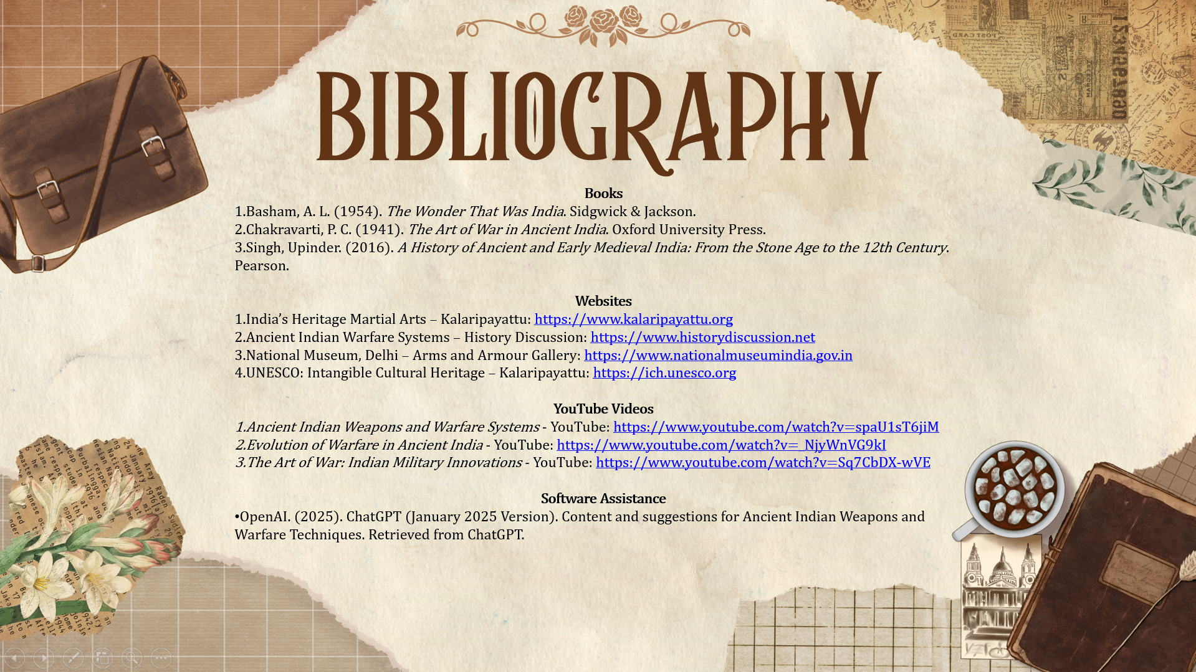

Slide 26
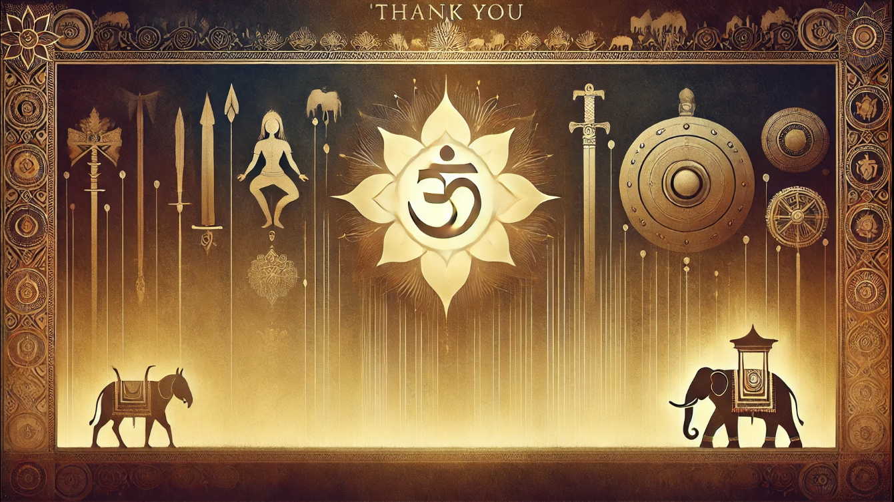
PRESENTED BY:
ANJALI SINHA (D111)
NAINA SINGH (D115)
ABHISHEK UPADHYAY (D119)
VRAJ VED (D120)
DARSHAN VED (D121)

